Slide 1
Certification
and
Training

Slide 2
Outline
• Organizational information security
– In general
– At OSU
personnel
• Professional information security certification

Slide 3
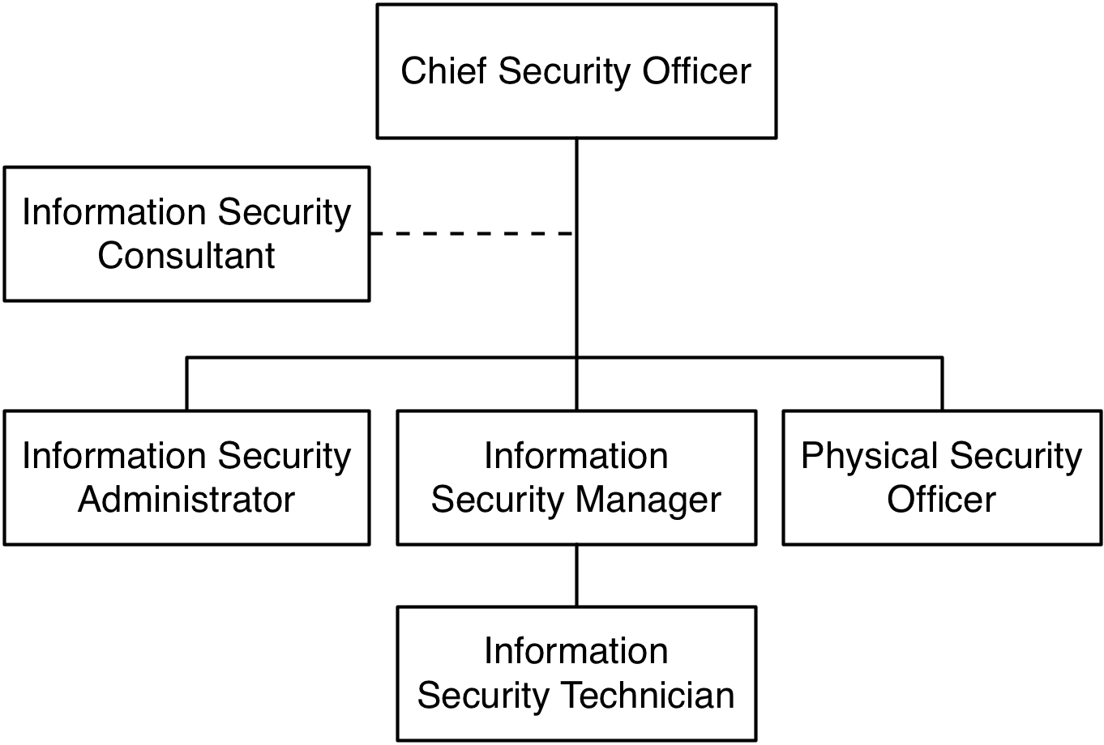
Information
Security
Personnel
(1)
Positions in Information Security

Slide 4
Information
Security
Personnel
(2)
• Chief security officer (CSO): Head of security,
CIO and execs
– Manages org’s info. sec. program and policies
– Works on strategic, tactical, operational plans
– Handles security budgeting, personnel
– Usually needs college degree and CISSP
reports to
• Security manager: handles org’s info. sec. program on a daily basis
– Develops/implements policies under CSO’s guidance
– Monitors progress of organization’s info. sec. program
– Handles incident response, disaster recovery, risk assessment
– Usually needs college degree, CISSP
Security technician: deploys/manages firewalls, IDSs, etc. under security manager’s guidance

Slide 5
OSU
Information
Org
Michael
Drake
osu
President
I
I
Michael Hofherr VP, CIO
Security
Chart
Personnel
Board of
Trustees
I
I
I
Kristina Davis Interim Director, Finance
I
Katherine Keune Chief Commun. Officer
I
Helen Patton Assoc. VP, Chief Info. Sec. Officer
I
I
Liv Gjestvang Assoc. VP, Learning Tech.
I
Robert Griffiths Assoc. VP, Online Edu.
I
I
Leslie Wei bush Special Asst. to VP, CIO
Diane
Dagefoerde
Deputy CIO
David
Kieffer Assoc. VP, Admin. Syst.
Susan
Hatfield
Exec. Asst.
Laura Palko
HR Director
I
Gary Clark Director Information Risk Mgmt.
I
Diana Morawetz Office Admin. Associate
I
l
Steve Romig Director, Security; Advisor
l
Ryan Traptow Assoc. Director, Security
I
Rich Nagle
Deputy Chief Info. Sec. Officer
Holly Drake
Chief Privacy
Officer
Security
managers;
technicians below
Source: https://orgchart.osu.edu/organization/ocioodee

Slide 6
Professional
Certifications
• Information System Audit and Control Association (ISACA)
– Certified Information Systems Auditor (CISA)
– Certified Information Security Manager (CISM)
• Int’l. Information Systems Security Certification
Consortium (ISC)²
– Certified Information System Security Professional (CISSP)
– System Security Certified Practitioner (SSCP)
• Int’l. Information System Forensics Association (IISFA)
– Certified Information Forensics Investigator (CIFI)
Many require candidates have professional security experience/college degree, no criminal record

Slide 7
Other
Certifying
Organizations
• System Administration, Networking, and Security Institute
(SANS)
• Global Information Assurance Certification (GIAC)
• Information System Security Association (ISSA)
• American National Standards Institute (ANSI)
• Computer Professional for Social Responsibility (CPSR)
• Companies: Microsoft, Cisco, etc. (vendor-specific)
• Int’l. Society of Forensic Computer Examiners (ISFCE)
• CompTIA: A+ certs (vendor-neutral)

Slide 8
CISSP
Concentrations
• Information
Professional
Architecture
Information Professional Engineering
• Information
Professional
System Security Architecture
(ISSAP): Concentration in
System Security Engineering
(ISSEP): Concentration in
System Security Architecture
(ISSMP):
Concentration in
Management

Slide 9
CISA
Exam
Content
Areas
• CISA Exam (Six Domains)
– IS Audit Process (10%)
– IT Governance (15%)
– Systems and Infrastructure Life
Cycle (16%)
– IT Service Delivery and Support (14%)
– Protection of Information Assets (31%)
– Business Continuity and Disaster Recovery
(14%)

Slide 10
CISM
Exam
Content
Area
• CISM Exam (Five Domains)
– Information Security Governance
– Risk Management (21%)
(21%)
– Information Security Program Management
(21%)
– Information Security Management (24%)
– Response Management (13%)

Slide 11
CISSP
Exam
Content
Area
(1)
• CISSP Exam (10 Domains)
–
–
–
Access Control Systems and Methodology
Applications and Systems Development
Business Continuity Planning (BCP),
Disaster Recovery Planning (DRP)
Cryptography
Law, Investigation and Ethics
Operations Security
Security
–
–
–
–
–
–
–
Physical
Security
Security
Security
Architecture and Models
Management Practices
Telecommunications and Network Security

Slide 12
SSCP
Exam
Content
Area
• SSCP Exam (7 Domains)
– Access Control
– Administration
– Audit and Monitoring
– Cryptography
– Data Communications
– Malicious Code/Malware
– Risk, Response and Recovery

Slide 13
CIFI
Exam
Content
Area
• CIFI Exam (6 Domains)
– Auditing
– Incident Response
– Law and Investigation
– Tools and Techniques
– Traceback
– Countermeasures

Slide 14
Training,
Seminars
and
Conferences
• http://www.issa.org/
• http://www.isaca.org/
• https://www.isc2.org
• http://www.ansi.org/
• http://www.sans.org/
• http://www.giac.org/
• http://www.infoforensics.org

Slide 15
Professional
Publications
• ISACA: Information Systems Control
Journal
• (ISC)²: The (ISC)² Journal (Information
Systems Security)
• ISSA: The ISSA Journal

Slide 16
Chapters and
Membership
• Chapters: local and worldwide
• Membership
– ISACA is a leading information technology organization representing more than 50,000 individual members in more than 140 countries.
– ISSA has over 13,000 members worldwide

Slide 17
Summary
Infosec personnel generally include security manager, and technicians
• Real-world org charts may vary
CSO,
• Professional organizations
• Recommendations:
– CIS/CSE Majors:
• CISSP (most prestigious)
• SSCP
– MIS (College of Business)
• CISA
• CISM
offer
infosec
certs

Slide 18
Reference
[1] Class note by Adam C. Champion, Ph.D.

